Slide 1
How to Attract Younger Members to Lionism

Slide 2
Who Are “Younger” Members?
Teens graduating from high school
College students looking to improve their resumes and grad school applications
20-somethings buying a new home in your communities
30-somethings with kids who want to set a good example for the kiddos and improve their neighborhoods
40-somethings who want to give back

Slide 3
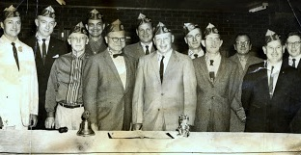
How do they see us?
Notes:
Lions Clubs, as we know them today are a hybrid of social clubs and volunteer organizations. In eras past, this suited a world where most communication was face-to-face. And when men needed a “boys” night out to get a break from their families.

Slide 4
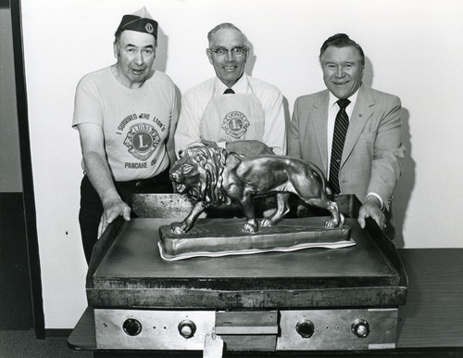
Notes:
That image of 1960s and 1970s-era meetings persists today.

Slide 5
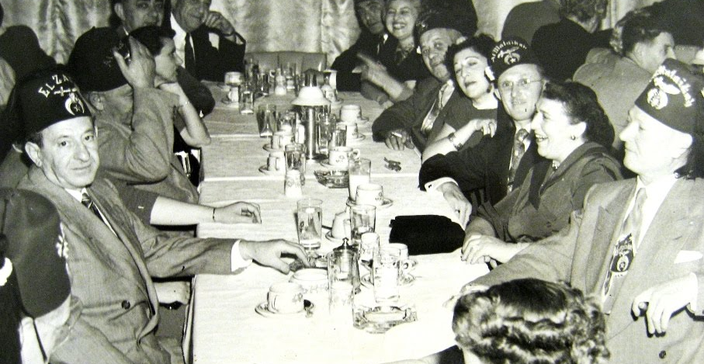
Perception Matters
Notes:
In this electronic age, though, younger people are rarely interested in social organizations. Therefore our own social emphasis puts up a roadblock between us and younger generations, many of whom still wonder if we have secret handshakes or wear funny hats.
This is what we need to change.

Slide 6
Notes:
The first way we can start to change our image and change our volunteer dynamic is to eliminate a series of road blocks we have put up between ourselves and younger generations. We put these roadblocks up in the name of “tradition” and “convenience”, but it’s time to tear them down and make ourselves accessible and appealing to young people with families and new careers.

Slide 7
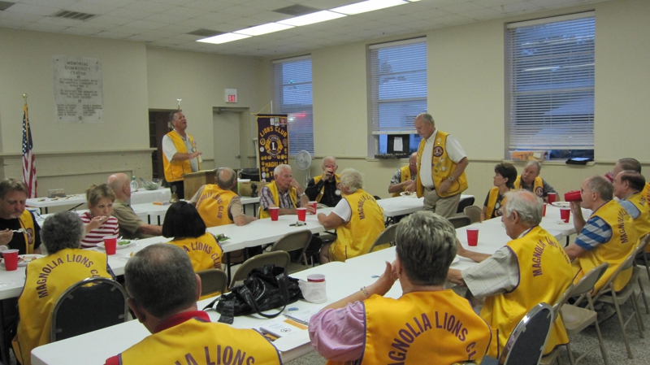
1 Meeting = ~ 2 hours of evening family time where we do not directly serve the community—EVERY TWO WEEKS
Notes:
Roadblock #1: Our Meetings
Word from most young people on the street who shake hands with Lions members is that they do want to volunteer, but that they just don’t have time to come to meetings. Many will suggest, however, that if there’s ever a service project, they’d like to come and help. They also tend to donate money very generously. So in a world where we desperately need to attract younger volunteers, we need to take this feedback and ask how we can apply this to our Lions Club. Why are meetings so mandatory to stay in the loop? Why is meeting attendance the first thing we ask for before we invite them to be members and accept their first dues check?

Slide 8
Roadblock Solution:
Meetings only once per month
Geared toward board members organizing projects and volunteer groups
Emphasized as optional
No meals
Families welcome
Focus on using our hands to create during meetings
Notes:
Let’s start by thinking of why we meet, usually twice a month, for a sit-down formal meeting with Roberts Rules of Order. Can we make our meetings volunteer-focused? A get-together where we welcome family participation? Let’s have the kids put together goodie bags to hand out to the public while Lions fold brochures and plan a new community garden.

Slide 9
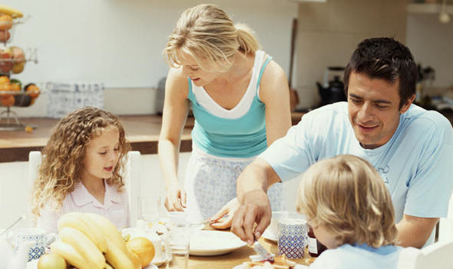
What Time Did You Arrive Today?
Notes:
Roadblock #2 – Old-Fashioned Thinking...themes, times, and structure. Registration was from 8-9am this morning. In Lansing. Now, we’ll all be done today by 3:15pm. Why are we scheduling everything so early. If we’re thinking of families, this is really discouraging for families. Moms and dads had to leave the house between 6-7am mostly—just as the kids need to get fed and have their teeth brushed. When babysitters aren’t available. When neighbors can’t watch the kids.
If we want to involve younger people, let’s not set up barriers of old-fashioned thinking.

Slide 10
Roadblock Solution
Time your meetings according to parent and young professional schedules.
What time you do ask of people should be put to good use SERVING the community, not just talking about it (isn’t that why we have boards?).
Come up with modern themes and fresh ideas for gatherings.
Notes:
With lots of respect and gratitude for our hard-working volunteers, a lot of our gatherings, banquets, parties, and conventions have had themes like “swing dancing” and “doo-wop”. Most people in their 20s and 30s couldn’t even tell you what doo-wop is. It isn’t an exciting or fun theme for anyone who doesn’t remember those many decades ago. We need to modernize and keep our fun a little more current.
Right now, can someone name some great modern raffle prizes that would appeal to younger people? iPad
Apple Store Gift Card
Tigers Tickets PS4

Slide 11
Email
Website building
Cell phones
Texting
Facebook
Notes:
Roadblock #3: Fear of Technology
Face-to-face communication is really becoming a thing of the past. When people need to communicate—as professionals or as friends—they text, email, and post on social media like Facebook. Our communities have moved to the Internet. So if we aren’t online we aren’t really in our communities fully. We can’t serve our communities if we don’t go where they are. This also goes back to what makes our face-to-face meetings out-of-touch.
Quiz: Which social media site do you think is the “it” place to be for teens in 2014? A. Facebook
B. Twitter
C. LinkedIn
D. Pinterest
Answer is none of the above. Those are already passe. Another Quiz: How many of you know what a “Patch” website is? Or know if you have a Patch website for your community? And how many of you write articles for it?

Slide 12
Look out, it’s the Hartland Moms!
Notes:
Founded in July, 2012 with a founding membership of 250. Today, their membership is approximately 1,234 women just in one town.
How many members does the Hartland Lions Club have?

Slide 13
< 10
Notes:
Very dedicated members. But really about 2-3 members do an incredible amount of work. What’s the difference? Technology. Community goals. Shared interests.

Slide 14
Roadblock Solution
Make time in your schedule to learn new technology. Get a new phone. Practice texting. Practice building a free website. Get an email address.
If you don’t feel comfortable with technology, engagement with someone who can teach you.
Build a club website
Build a club Facebook page
Have a club email address
Set up a club PayPal account

Slide 15
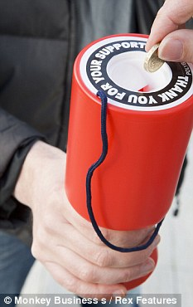
How Many Fundraisers Does the Average Family Do Per Year?
Notes:
Roadblock #4 – How We Give Back. Young people want to see the impact.
The average child in recent generations starts fundraising at the age of 5. Lily over here is in the first grade and has had FOUR fundraisers this year so far (which reminds me, if anyone would like to donate to her “jump roping for heart health event”, please let me know. So these kids and parents are burned out of fundraisers and have no incentive to join a community club that does more fundraising.

Slide 16
Roadblock Solution:
Let’s put the SERVICE back in WE SERVE.
Center most of your club activities around activities that would look good in a brochure and sound impressive on a resume or college application.
Build ramps, clean up parks, plant gardens/trees, paint senior centers, repair playgrounds, change light bulbs, shovel snow, etc.

Slide 17
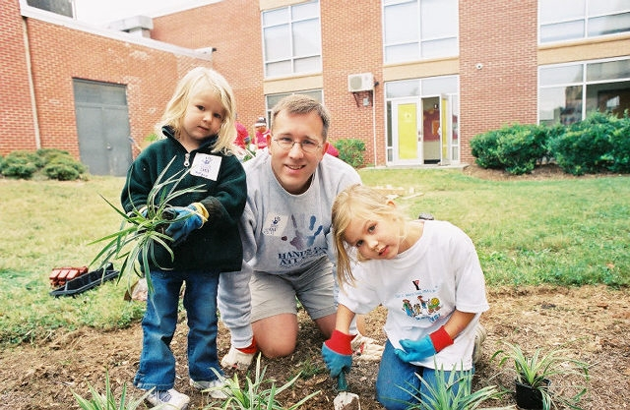
The New Faces of Service

Slide 18
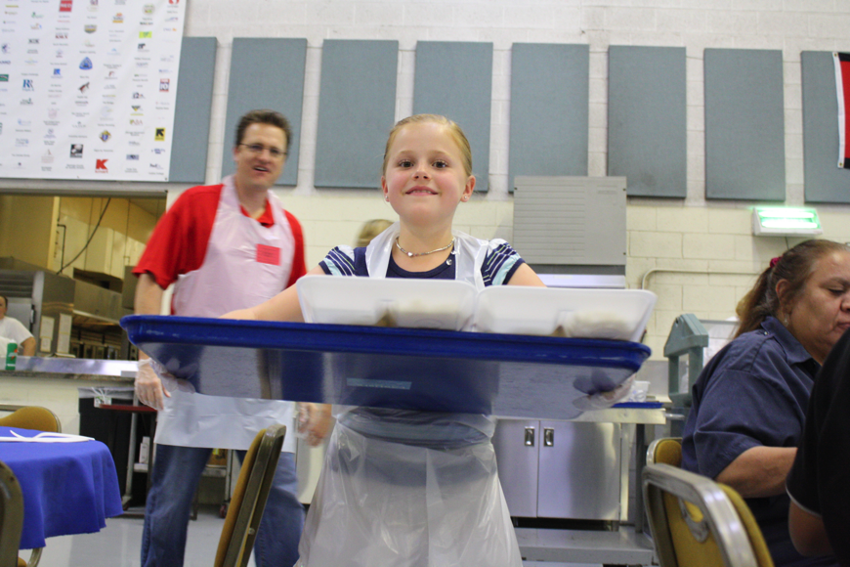

Slide 19
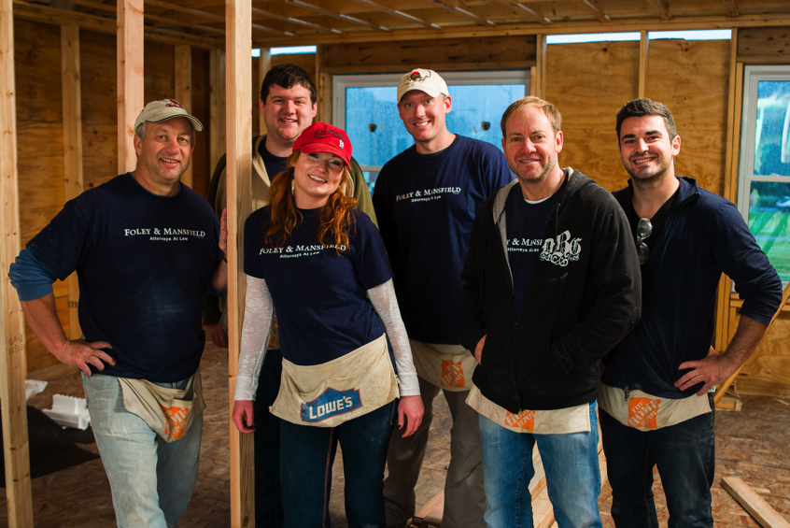

Slide 20
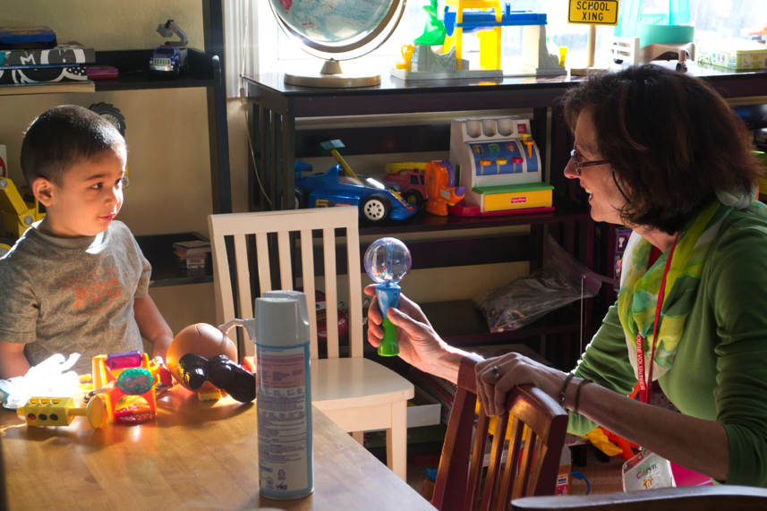

Slide 21
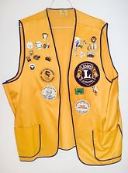
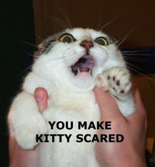
Oh, and one more thing...
Did you notice anyone in those photos was wearing a vest? Please, let’s get on board with just wearing t-shirts (not polo shirts.) T-shirts are affordable, versatile, and not embarrassing!

